Slide 1
Quicksort Algorithm
Higher Level only

Slide 2
Quicksort
The Quicksort algorithm is recursive.
That means that the sorting algorithm is recursively repeated on subsets (sublists) of the same problem until a specific endpoint is reached - in this case the end point is when there is only one element in the list.

Slide 3
Quicksort
First , the algorithm starts by defining a pivot value. There are several options for this, such as selecting the first or last item in the list. We are going to use the last item in the list for our example
The first thing Quicksort does is create two sublists.
The first sublist is all the values in the list (excluding the pivot value) that are less than the pivot value.
The second sublist is all the values in the list (excluding the pivot value) that are greater than or equal to the pivot value.

Slide 4
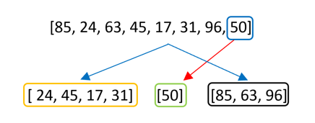
The pivot value is the last item - 50
There are two sublists created - one with all values less than 50 and one with all values greater than 50
The list has started to be sorted.

Slide 5

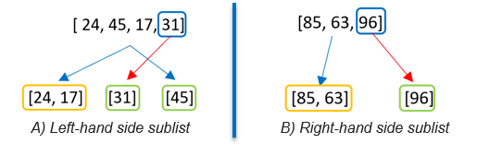
If at this point the algorithm concatenated (put together) the three separate lists, it would look like this
But before the sublists are concatenated, ,the Quicksort algorithm is recursively called on the left hand side sublist and also on the right hand side sublist.
This means that the algorithm is repeated on each sublist
The algorithm is then recursively applied again to each new set in the same way. It keeps going until all the sublists are of length one. The algorithm can then stop

Slide 6
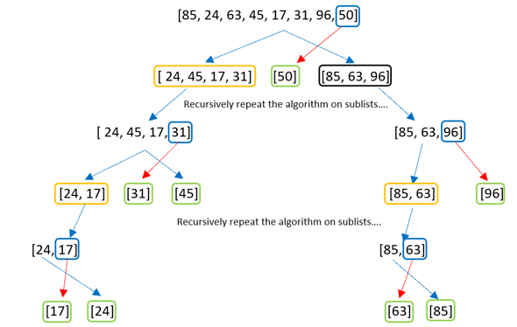

Once all the sublists have a length of 1, they are returned, now in order to create a sorted list.

Slide 7
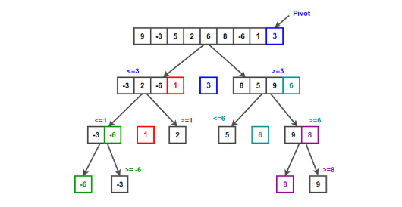
Quicksort Example
https://www.techiedelight.com/quicksort/

Slide 8
Python Code
https://repl.it/@suzannelinnane/Quicksort

Slide 9
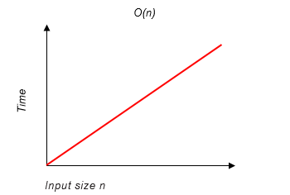
Big O notation
Big O notation can be used to describe the time complexity of an algorithm. This notation always features n, the input size.
For example, Linear search is an O(n) algorithm. This means that the time taken for the algorithm to complete is linearly proportional to the input size n.

Slide 10
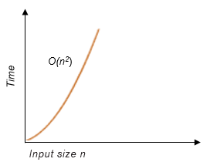
Equivalence classes group algorithms that have an equivalent complexity.
Some classes are less complex than O(n) and some are more complex.
O(n²) is a more complex equivalence class than O(n). Algorithms in this class have a quadratic complexity. This means that is grows in proportion to the square of the input size. If we double the input size, the output quadruples.
An example of an algorithm that belongs in the O(n²) class is a bubble sort.

Slide 11
Efficiency Quicksort
A quicksort involves picking a pivot and forming two sublists and then calling quicksort recursively on each sublist.
The worst case would be where we pick a pivot value that is greater than all the other values. This would result in two sublists - one of length 0 and one of length n-1. To get to this stage, n-1 comparisons were required as the pivot value would need to be compared with all other values.
Next, the quicksort function is called on the unsorted sublist of length n-1. A new pivot is needed and again the worst case scenario is if the two new sublists were of lengths 0 and n-2. Getting to this stage would require n-2 comparisons.

Slide 12
Efficiency - Quicksort
In general, the first step required n-1 comparisons, the second requires n-2 comparisons and so on. This is repeated until we reach step n, when we need n-n or 0 comparisons.
The total number of comparisons will be: (n-1) +(n-2) +...+(n-n)
(n-n) = 0, leaving (n-1)+(n-2)+...+(n-(n-1)). But (n-(n-1)) is equivalent to 1. Similarly (n-(n-2)) is equivalent to 2.
So we can simplify the total comparisons to (n-1)+(n-2)+ …+2+1

Slide 13
Efficiency - Quicksort
If we were to add all the terms up, there would be
1+2+3+.....+n
We are only summing to n-1 so that means there are (n-1) terms to be added together.
1+2+3+......+(n-3)+(n-2)+(n-1)
We can rearrange this these terms:
(n-1) + 1 + (n-2) + 2 + …….etc

Slide 14


Efficiency - Quicksort
(n-1) + 1 = n. (n-2) + 2 = n. Each pair will equal n. There are (n-1) numbers in total, giving pairs which are each equivalent to n.
Our total can be rewritten as
From our previous examples, the constants and lower order terms are not significant so we are left with n²
The worst case time complexity for quicksort is O(n²)

Slide 15
Quicksort Complexity Summary
The worst case scenario will happen if the pivot is greater than the other values resulting in two lists - one with a length of n-1 and the other with zero elements. There would be n-1 comparisons made. If each pivot continued to be greater than the other elements then the resulting sum of the comparisons would be
(n-1) + (n-2) + …+2+ 1.
If we rearrange these, we find that there are n-1 pairs, each equivalent to n (n-1+1 etc). Therefore the total can be written as
Constants (½) and lower order terms (n) are not significant so we are left with n²

Slide 16
Quicksort Summary
The quicksort algorithm is a sorting algorithm that works by partitioning a list into smaller sub-lists, and then recursively sorting each sub-list.
In the worst case scenario, the pivot element chosen for partitioning is either the smallest or the largest element in the list. This means that each recursive call only reduces the size of the list by one element.
As a result, if the original list is of size 'n', the algorithm will need to make 'n' recursive calls, each of which takes O(n) time to partition the list.
Therefore, the total time complexity of the quicksort algorithm in the worst case scenario is O(n²), which means that the time taken by the algorithm grows quadratically with the size of the input list.
In simpler terms, this means that for very large input arrays, the quicksort algorithm may take a very long time to run in the worst case scenario.

Slide 17
Perform a quicksort on the following set of data using the last number as the pivot
3,6,1,5,8,2,4,13
Perform a quicksort on the following set of data using the last number as the pivot
54, 26, 93, 17, 77, 10, 7, 55, 20
Perform a quicksort on the following set of data using the first number as the pivot
14, 17, 13, 15, 19, 10, 3, 16, 9, 12

